Slide 1
INVENTORY MANAGEMENT SYSTEM
GROUP-6

Slide 2
TEAM MEMBERS:
Employee Id:
2504309
2505835
2504993
2507358
2507203
2504770
2503941
2503636
2507340
2506668
Employee Name:
-Sanu(Front-End-Lead)
-Sangamesh
-Ravindra Suthar(Back-End-Lead)
-Ruchika aglawe
-Salum madhu
-Sachin Shelake
-Ratika Kumari
-Priya Naveen
-Yeswanth Reddy
-S Richie

Slide 3
INDEX
INTRODUCTION
OBJECTIVES & PURPOSE
PROJECT OVERVIEW
INVENTORY
INVENTORY MANAGEMENT
TECHNOLOGIES USED
FEATURS AND SPRING BOOT COMPONENTS
MODULES
FLOWCHART
ADVANTAGES
CONCLUSION

Slide 4
INTRODUCTION
A project for an inventory management system that allows users to easily manage and maintain their inventories.
Users can add inventory, delete inventory, enter inventory quantity and other details, update inventory status, and more using the inventory management system.
Inventory management aims to streamline stocks as much as possible in order to minimize both gluts and shortages.
It also keeps track of the current stocks in the store.

Slide 5
Objectives and Purpose
Keep a track record of each item.
Keep track of sales and purchases.
Keep track of your customers' accounts and purchase reports. Maintain the vendor's account as well as the sales reports.
To provide the appropriate degree of customer service while allowing for cost-effective operations and inventory investment minimization.

Slide 6
PROJECT OVERVIEW
The selling and buying of products is the focus of this inventory management system.
It's a straightforward project that keeps track of stock levels. This system is user-friendly and offers a lovely user interface.
Reports are generated for the list of Items, Sales, Vendor, Customer, and Purchases by the system.

Slide 7
What is inventory?
Inventory is a collection of items stored in anticipation of future demand.
The items and supplies held by a company for resale, manufacture, or use are referred to as inventory or stock.

Slide 8
INVENTORY MANAGEMENT
Inventory management is the process of determining a company's stock mix and the various demands placed on that stock.
Inventory management aids businesses in determining which goods to order and when to order it. It keeps track of merchandise from purchase to sale.
Every other commercial enterprise relies on inventory management.

Slide 9
USED TECHNOLOGY
FRONTEND TECHNOLOGIES & TOOLS :
Angular
Visual Studio Code
BACKEND TECHNOLOGIES & TOOLS:
MySql
Spring Tool Suite
Spring Boot
JPA( Java Persistent API ), Hibernate
Tomcat Server
TESTING TECHNOLOGIES & TOOLS:
Postman, TestNG

Slide 10
Inventory Management system features:
User Registration
User Login
Item Management
Purchases Management
Sales Management
Customer Management
Spring Boot Components:
Controller
Entity
Service
Repository

Slide 11
MODULES:
Admin
Add Item
View, Update and Delete Item’s
View Sale’s Report’s
View Purchase Report’s
Add Customer
View, Update and Delete Customer’s
Add Vendor
View, Update and Delete Vendor’s
Customer
View Item’s
Purchase Item
View Purchase History
View, and Update Profile
Vendor
Add Item’s
View , Update and Delete Item’s
View Sales Report
View Profile

Slide 12
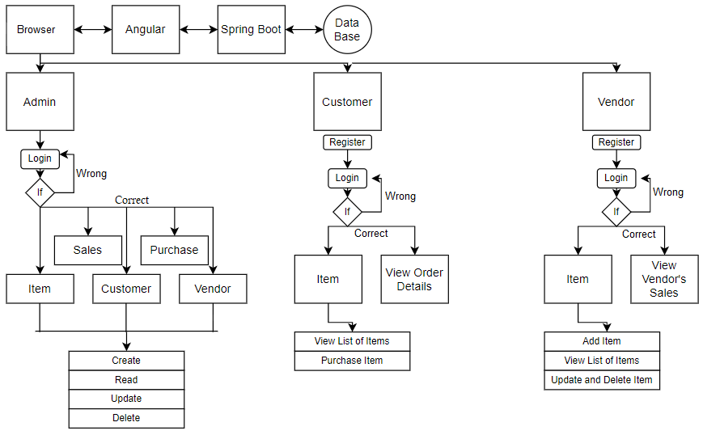
FLOWCHART

Slide 13
ADVANTAGES:
Better Inventory Accuracy.
Reduced Risk of Overselling.
Cost Savings.
Avoiding Stockouts and Excess Stock.
Greater Insights.
Better Terms With Vendors and Suppliers.
More Productivity.
Increased Profits.
A More Organized Warehouse.
Better Customer Experience.

Slide 14
CONCLUSION:
A proper Inventory Management System must be used to manage stocks.
All inventory management has to do is to keep accurate records of items that are ready for shipment.
Inventory management is also important for keeping costs down while meeting regulations. Supply and demand are a delicate balance, and inventory management promises to ensure that the balance is undisturbed.

Slide 15
THANK YOU

